Slide 1
Data Warehousing Basics
Data Marts
Level - Learner

Slide 2
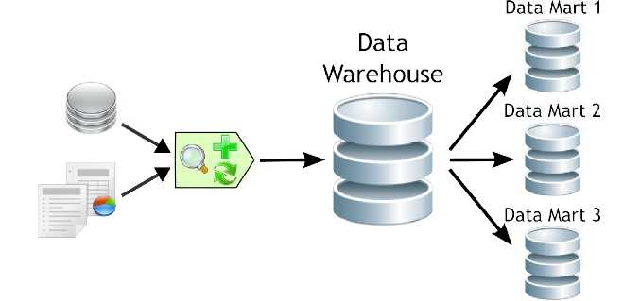
Overview
A Data mart is a small data warehouse focused on a specific area of interest.
Data warehouses can be subdivided into data marts for improved performance and ease of use within that area.
Notes:
Data mart fundamentals session provides knowledge and understanding of Data mart overview, types of data mart, Architecture of data mart etc.

Slide 3
Objectives
After completing this session, associate will be able to :​
Define Data mart?
List the difference between Data mart and Data warehouse.
Describe the Dependent & Independent Data mart.
Explain the Advantages of Data mart.

Slide 4
Data mart
The primary purpose for its existence is to support data dependent business functions related to reporting, trending, analysis & presentation.
Data mart is a simple form of a data warehouse that is focused on a single subject.
It provides the business unit with easy access to data in the warehouse.
Notes:
Data mart is a decentralized subset of data found either in a Data Warehouse or as a standalone subset designed to support the unique business unit requirements of a specific decision-support system.
Data marts have specific business-related purposes such as measuring the impact of marketing promotions, or measuring and forecasting sales performance, and so on.

Slide 5
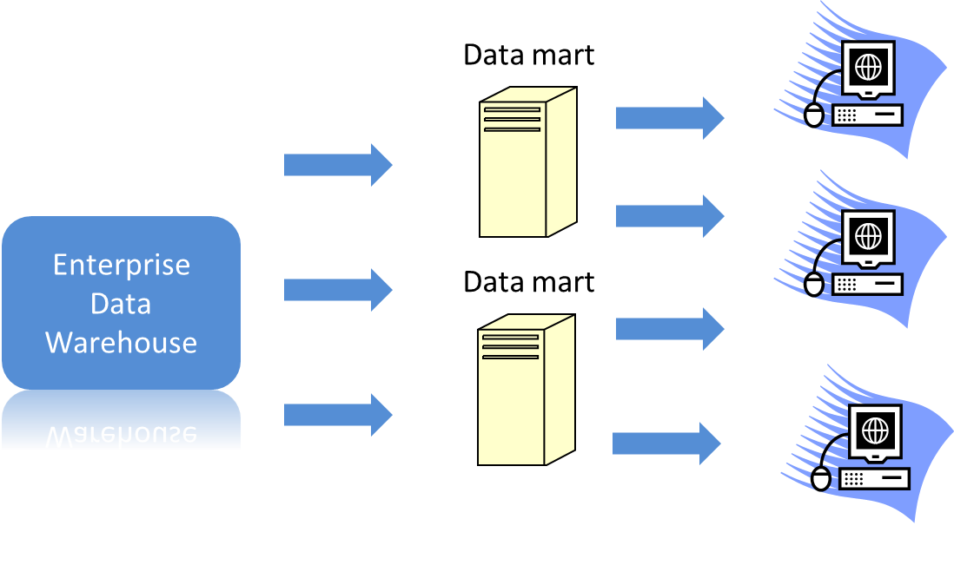
Basic Architecture of Data mart

Slide 6
Data mart: Features
The following are few important features of data marts:
Low cost.
Controlled locally rather than centrally, conferring power on the user group.
Contain less information than the warehouse.
Rapid response.
Easily understood and navigated than an enterprise Data Warehouse.
Within the range of divisional or departmental budgets.
To provide data in a form that matches the collective view of a group of users.

Slide 7
Data mart: Types
Following are 3 types of Data marts:
Independent
Dependent
Hybrid

Slide 8
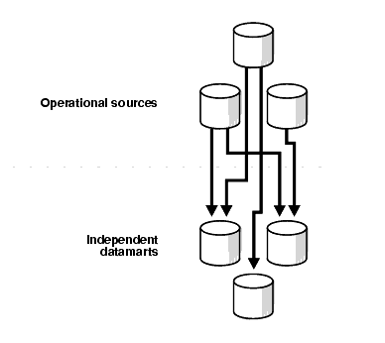
Independent Data mart
What is an Independent Data mart?
An independent data mart is created without the use of central data warehouse.
This could be desirable for smaller groups within the organization. It is not, however, the focus of the guide.
Architecture of Independent Data mart

Slide 9
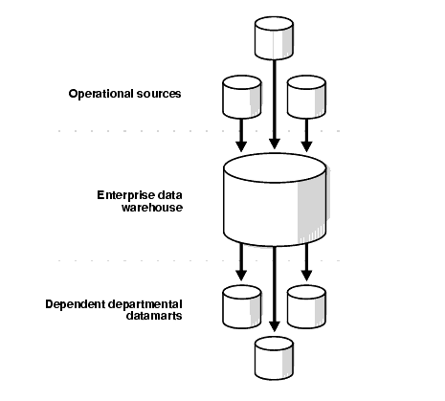
Dependent Data mart
What is a Dependent Data mart?
A dependent data mart allows you to unite your organization’s data into 1 data warehouse.
Architecture of Dependent Data mart

Slide 10
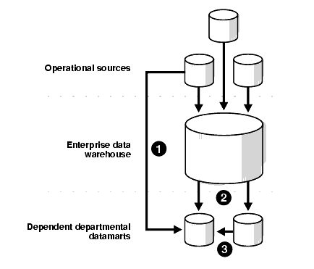
Hybrid Data mart
What is a Hybrid Data mart?
A hybrid data mart allows you to combine input from sources other than a data warehouse.
This could be useful for many situations, especially when you need ad hoc integration, such as after a new group or product added to the organization.
Architecture of Hybrid Data mart

Slide 11
Advantages of Data Mart over Data Warehouse
Data mart advantages:
Typically single subject area and fewer dimensions.
Limited feeds.
Very quick time to market (30-120 days to pilot).
Quick impact on bottom line problems.
Focused user needs.
Limited scope.
Optimum model for DW construction.
Low Cost.
Allows prototyping.
Quick response to queries.

Slide 12
Data mart Disadvantages
Data mart Disadvantages:
Does not provide integrated view of business information.
Uncontrolled proliferation of data marts results in redundancy.
More number of data marts complex to maintain.
Scalability issues for large number of users and increased data volume.

Slide 13
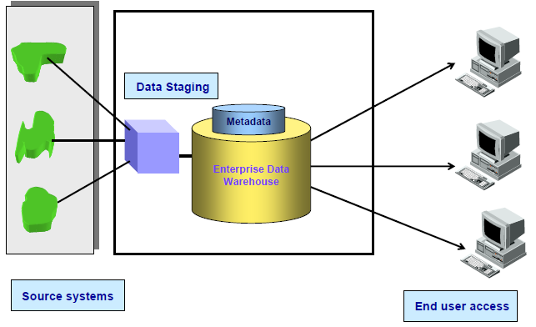
Architected data warehouse

Slide 14
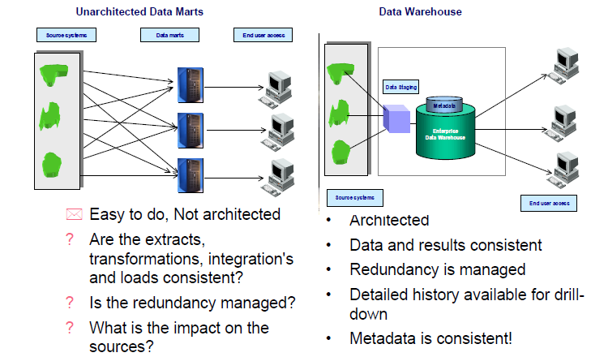
Un-architected Data mart vs Data warehouse
Easy to do, not architected.
Are the extracts, transformations, integration’s and loads consistent?
Is the redundancy managed?
What is the impact of the sources?
Architected
Data and results consistent.
Redundancy is managed.
Detailed history available for drill-down.
Metadata is consistent.

Slide 15
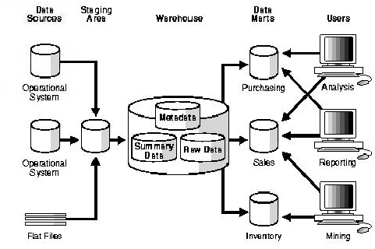
Example for Data mart

Slide 16
Real Life Example for Data mart
There is a Client “A” who is willing to analyze the data for the “Finance Department” only.
He is not willing to spend more money for it and has only a small amount of data.
He just wants to store data for 4 to 5 years.
He needs a fast response system, so that he can get the results of his queries fast.
As per the requirement of the client we need to opt for Data Mart over Data Warehouse.
He has small amount of data and needs it just for 4 to 5 years.
He wants a fast response time.
He is much focused on a single domain of Finance.
He is not willing to spend more amount for his reports.
Notes:
General Tips:
We must analyze the requirement first before proceeding towards Data Warehouse or Data Mart.
If requirements are less then we must follow the Data Mart approach.

Slide 17
Questions

Slide 18
Test your understanding
Explain Data mart?
Explain Dependent Data mart?
Explain difference between Data mart & Data warehouse?

Slide 19
Recap
After completing this session, associate should be able to :​
Define Data mart?
List the difference between Data mart and Data warehouse.
Describe the Dependent & Independent Data mart.
Explain the Advantages of Data mart.

Slide 20
Thank You
You have successfully completed the session on Data Mart.

